Slide 1
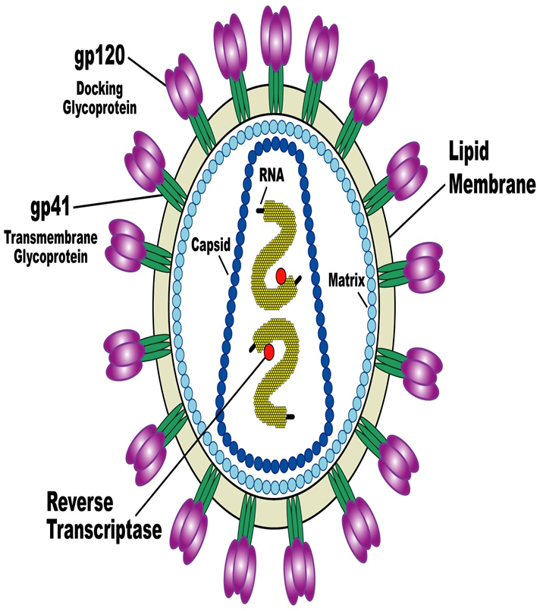


Namibia ART Guidelines: The use of a reduced EFV dose in the first lines ART regimens
Dr. Nuru Kaddu Mgori
(MD, MMED, PhD Candidate)
Arthur-Ashe HIV/AIDS Fellow
Senior Clinical Mentor
Oshana, Omusati and Kunene Regions
AVONZA Launch

Slide 2
Outline
Rationale of Namibia ART Guidelines
Epidemiology
HIV replication
Principle of ART (The use of reduced EFV 400mg)
Transition strategies EFV 600mg to EFV 400mg
ART and Management in special situations.

Slide 3
Namibia’s ART Guidelines
For use in both public and private sectors
Specifies patient eligibility criteria and proper ART preparation
Specifies standard treatment regimens and follow-up
Provides guidance on treatment adherence
Management of comorbidities
https://aidsfree.usaid.gov/sites/default/files/na_national_guidelines_art.pdf

Slide 4
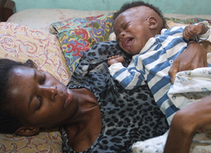
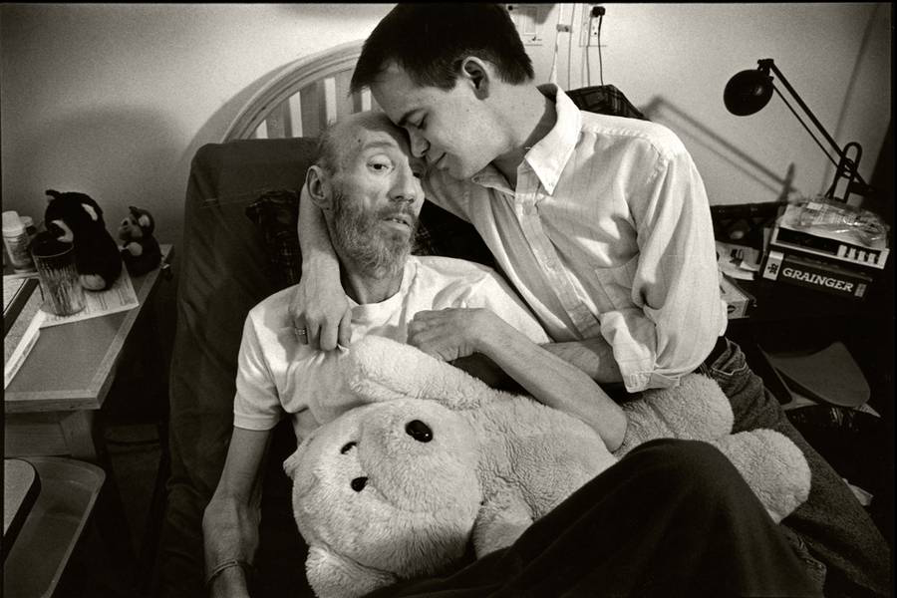
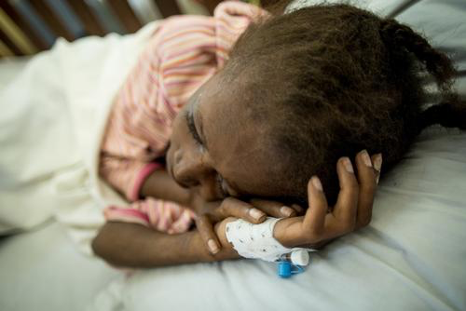
Courtesy: Dr T. Mekonen- Namibia AIDS conference 2016

Slide 5
Global summary of the AIDS epidemic  2016
Number of people living with HIV
Total
Adults
Women (15+ years)
Children (<15 years)
Total
Adults
Children (<15 years)
Total
Adults
Children (<15 years)
36.7 million [30.8 million–42.9 million]
34.5 million [28.8 million–40.2 million]
17.8 million [15.4 million–20.3 million]
2.1 million [1.7 million–2.6 million]
1.8 million [1.6 million–2.1 million] 1.7 million [1.4 million–1.9 million]
160 000 [100 000–220 000]
1.0 million [830 000–1.2 million] 890 000 [740 000–1.1 million]
120 000 [79 000–160 000]
People newly infected
with HIV in 2016
AIDS-related deaths in 2016
Source: WHO/(UNAIDS) Core Epidemiology Slides 2017

Slide 6
HIV Prevalence Rate of Pregnant Women, Biannual Surveys 1992-2016
Source: MoHSS report of the 2016 -National HIV Sentinel Survey, November 2016

Slide 7
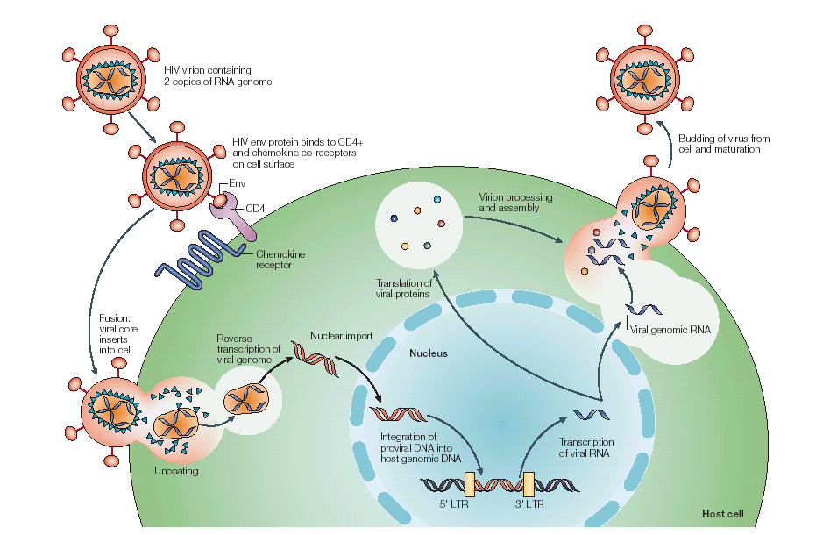
HIV-1 Life Cycle

Slide 8
Site of action of AZT
and other reverse
Transcriptase
inhibitors
(1) Viral genome
and reverse
transcriptase
enter cell.
(8) Final viral assembly
and budding
take place.
(2) DNA copy synthesized by reverse transcriptase.
Host cell
nucleus
Host cell
genome
RNA
DNA
(7) Viral membrane proteins are transported to host cell membrane.
(3) RNA degraded; second DNA strand
synthesized.
(6) Viral RNAs are
translated, yielding
viral enzymes
(including protease)
and structural
proteins.
DNA
DNA
(4) DNA circularizes (unintegrated provirus) or integrase functions
to incorporate DNA into host cell
genome (integrated provirus).
(5) With host cell activation, viral
DNA is transcribed,
yielding messenger RNAs
and viral genome RNA.
Site of action
of protease
inhibitors
Site of action
of antiretroviral drugs
under development

Slide 9
(1) Viral genome
and reverse
transcriptase
enter cell.

Slide 10
Site of action of AZT
and other reverse
Transcriptase
inhibitors
(1) Viral genome
and reverse
transcriptase
enter cell.
(2) DNA copy synthesized by reverse transcriptase.
RNA
DNA

Slide 11
Site of action of AZT
and other reverse
Transcriptase
inhibitors
(1) Viral genome
and reverse
transcriptase
enter cell.
(2) DNA copy synthesized by reverse transcriptase.
RNA
DNA
(3) RNA degraded; second DNA strand
synthesized.
DNA
DNA

Slide 12
Site of action of AZT
and other reverse
Transcriptase
inhibitors
(1) Viral genome
and reverse
transcriptase
enter cell.
(2) DNA copy synthesized by reverse transcriptase.
Host cell
nucleus
Host cell
genome
RNA
DNA
(3) RNA degraded; second DNA strand
synthesized.
DNA
DNA
(4) DNA circularizes (unintegrated provirus) or integrase functions
to incorporate DNA into host cell
genome (integrated provirus).
Site of action
of antiretroviral drugs
under development

Slide 13
Site of action of AZT
and other reverse
Transcriptase
inhibitors
(1) Viral genome
and reverse
transcriptase
enter cell.
(2) DNA copy synthesized by reverse transcriptase.
Host cell
nucleus
Host cell
genome
RNA
DNA
(3) RNA degraded; second DNA strand
synthesized.
DNA
DNA
(4) DNA circularizes (unintegrated provirus) or integrase functions
to incorporate DNA into host cell
genome (integrated provirus).
(5) With host cell activation, viral
DNA is transcribed,
yielding messenger RNAs
and viral genome RNA.
Site of action
of antiretroviral drugs
under development

Slide 14
Site of action of AZT
and other reverse
Transcriptase
inhibitors
(1) Viral genome
and reverse
transcriptase
enter cell.
(2) DNA copy synthesized by reverse transcriptase.
Host cell
nucleus
Host cell
genome
RNA
DNA
(3) RNA degraded; second DNA strand
synthesized.
(6) Viral RNAs are
translated, yielding
viral enzymes
(including protease)
and structural
proteins.
DNA
DNA
(4) DNA circularizes (unintegrated provirus) or integrase functions
to incorporate DNA into host cell
genome (integrated provirus).
(5) With host cell activation, viral
DNA is transcribed,
yielding messenger RNAs
and viral genome RNA.
Site of action
of protease
inhibitors
Site of action
of antiretroviral drugs
under development

Slide 15
Site of action of AZT
and other reverse
Transcriptase
inhibitors
(1) Viral genome
and reverse
transcriptase
enter cell.
(2) DNA copy synthesized by reverse transcriptase.
Host cell
nucleus
Host cell
genome
RNA
DNA
(7) Viral membrane proteins are transported to host cell membrane.
(3) RNA degraded; second DNA strand
synthesized.
(6) Viral RNAs are
translated, yielding
viral enzymes
(including protease)
and structural
proteins.
DNA
DNA
(4) DNA circularizes (unintegrated provirus) or integrase functions
to incorporate DNA into host cell
genome (integrated provirus).
(5) With host cell activation, viral
DNA is transcribed,
yielding messenger RNAs
and viral genome RNA.
Site of action
of protease
inhibitors
Site of action
of antiretroviral drugs
under development

Slide 16
Site of action of AZT
and other reverse
Transcriptase
inhibitors
(1) Viral genome
and reverse
transcriptase
enter cell.
(8) Final viral assembly
and budding
take place.
(2) DNA copy synthesized by reverse transcriptase.
Host cell
nucleus
Host cell
genome
RNA
DNA
(7) Viral membrane proteins are transported to host cell membrane.
(3) RNA degraded; second DNA strand
synthesized.
(6) Viral RNAs are
translated, yielding
viral enzymes
(including protease)
and structural
proteins.
DNA
DNA
(4) DNA circularizes (unintegrated provirus) or integrase functions
to incorporate DNA into host cell
genome (integrated provirus).
(5) With host cell activation, viral
DNA is transcribed,
yielding messenger RNAs
and viral genome RNA.
Site of action
of protease
inhibitors
Site of action
of antiretroviral drugs
under development

Slide 17

HIV Replication Cycle and Sites of Drug Activity Adapted:Levy JA. HIV and the Pathogenesis of AIDS. 2nd ed. Washington, DC: American Society for Microbiology; 1998:9-11
Integrase Inhibitors
PIs
NRTIs
NNRTIs
INSTIs
NRTIs
NNRTIs
T20
Cellular DNA
Protease Inhibitors
Attachment Inhibitors
TLE
Nucleus
New HIV
particles
HIV Virions
Reverse
Transcriptase
Integrase
Protease
Capsid
proteins
and viral
RNA
Entry
Inhibitors
Viral RNA
Unintegrated
double stranded
Viral DNA
CCR5
or
CXCR4
co-receptor
Integrated
viral DNA
Viral
mRNA
gag-pol
polyprotein
5
6
MIs
4
TIs
1
2
3
Translation
Assembly and Release
Transcription
Attachment
Uncoating
Reverse
Transcription
Integration
Notes:
17
17

Slide 18
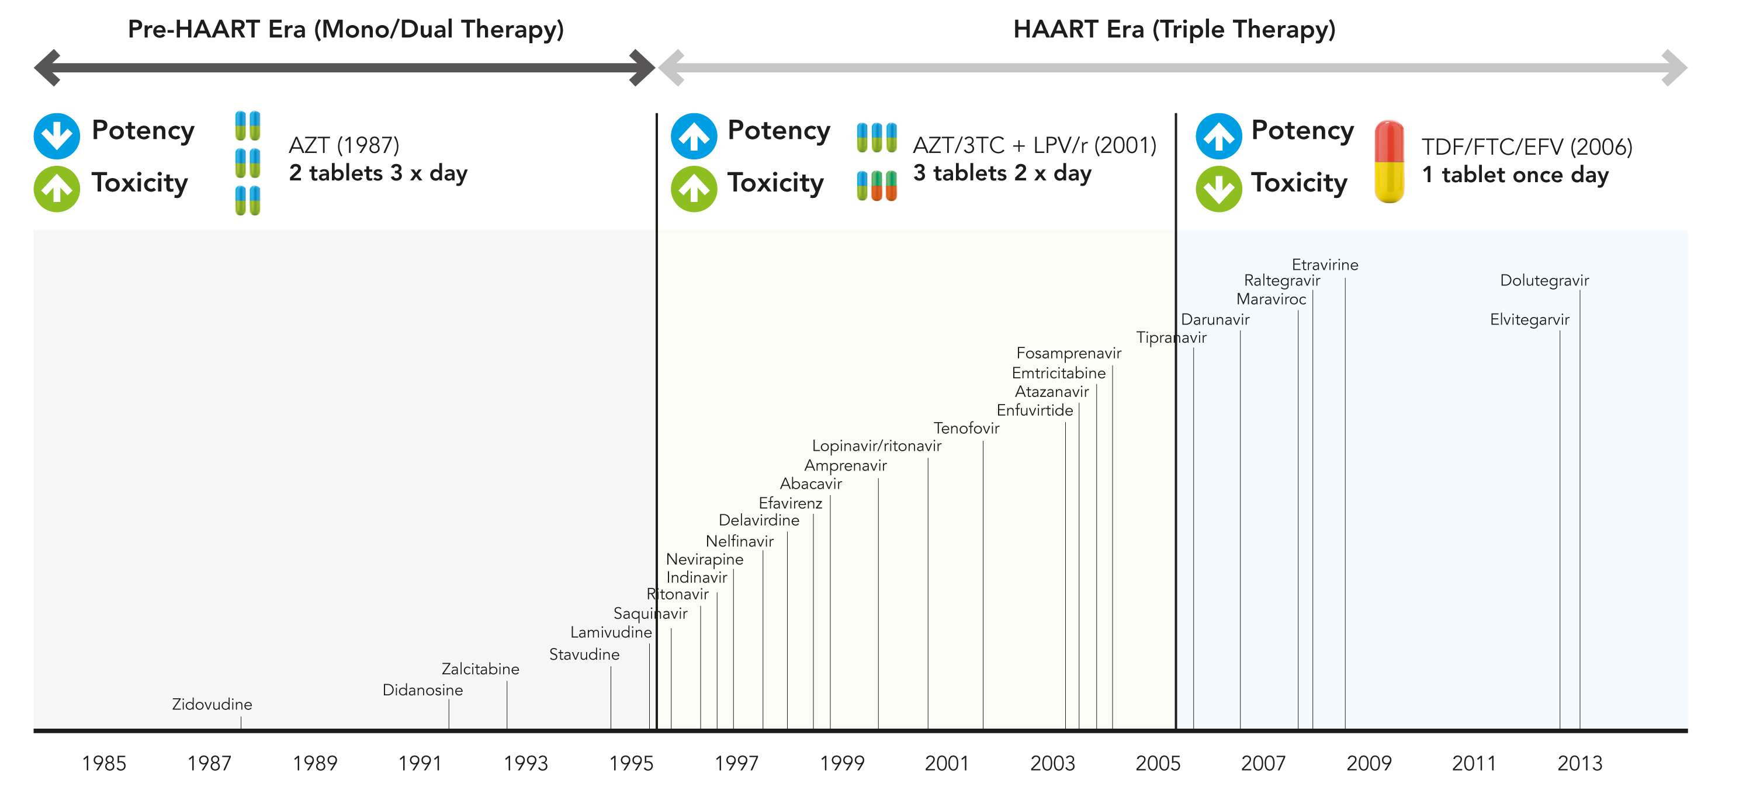
Evolution of ARV drugs: moving towards smarter and better HIV treatment options
Tenofovir alfenamide
✗
TLE400mg
✗
✗
✗
✗
✗
✗
✗
✗
2015
✗
withdrawn or no longer recommended ARVs
https://bpspubs.onlinelibrary.wiley.com

Slide 19
Documented Goals of ART
Durable viral suppression
Immune restoration
Decrease in opportunistic infections
Decrease in hospitalizations
Increase in survival
Decrease in HIV incidence
Decrease in HIV transmission
Restoration of hope and the opportunity to live long and well with HIV
Notes:
Step 2: ART Medicines (Slides 3 - 19), 60 minutes

Slide 20
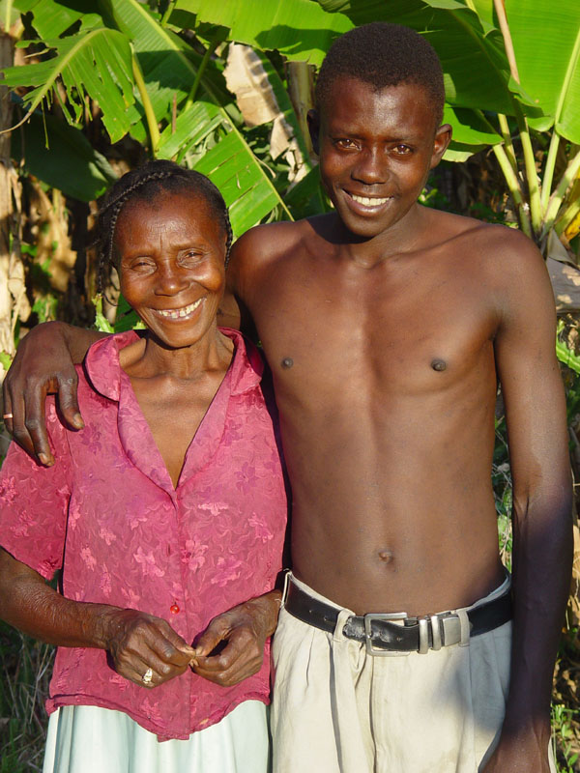
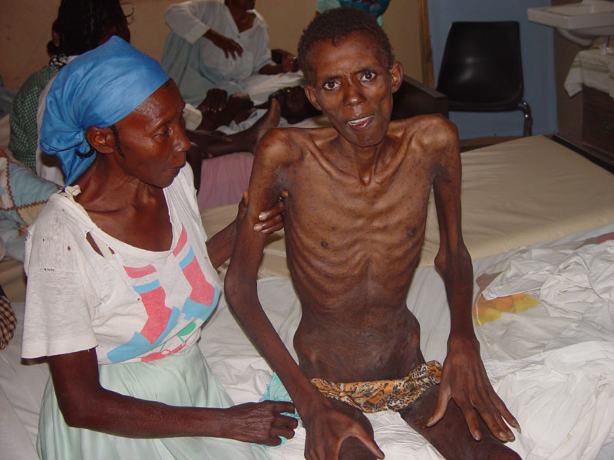
Effectiveness of Antiretroviral Therapy (ART)
Photograph by: David Walton
Copyright © 2003 Partners In Health
Before ART
Photograph by: David Walton
Copyright © 2003 Partners In Health
After 1 year on ART
Images source: David Walton. Copyright © 2003, Partners in Health.

Slide 21
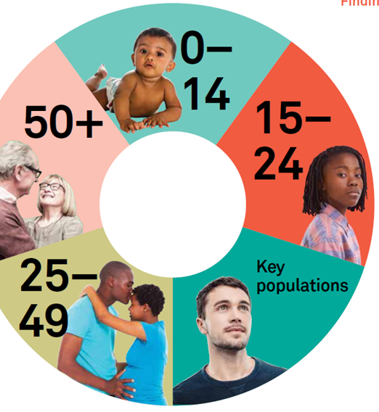
Who is eligible for ART?

Slide 22
Overview of when to start ART studies
1995-2005
2005-2010
2010-2013
2015
Several ACTG and CPCRA studies (early Post HAART Era): ART initiation CD4 < 200 cells/mm³ - Impact on AIDS mortality and major OIs incidence
TEMPRANO and START studies: (ART initiation at CD4 > 500 cells/mm³) impact on severe HIV morbidity & disease progression, without increase in severe adverse events
Observational studies (ART initiation at CD4 > 350 cells/mm³ ) impact on mortality, dz progression & non-AIDS events
CIPRA and SMART studies (ART initiation at CD4 ≤ 350 cells/mm³) Impact on HIV mortality, dz progression, & co-morbidities (TB)
HPTN 052: reduction of HIV transmission among HIV serodiscordant couples and risk of TB in adults (impact on HIV incidence)
Siedner MJ. START or SMART? Timing of Antiretroviral Therapy Initiation and Cardiovascular Risk for People With Human Immunodeficiency Virus Infection. Open Forum Infectious Diseases. 2016;3(1):ofw032. doi:10.1093/ofid/ofw032.
Notes:
Comprehensive International Program of Research on AIDS (CIPRA)

Slide 23
Discussion: How Soon to Start ART
Is Rapid ART feasible?
Same day ---< 14 days
What resources are needed to support same-day ART?
Experience in using the current first lines
What do the updated guidelines say?

Slide 24
Improved Clinical Outcomes With Rapid ART Initiation
START^{[1]} and HPTN 052^{[2]} studies resulted in universal recommendations for treating all persons with HIV infection
Systematic review of rapid ART initiation (4 RCTs in Africa, Haiti)
Compared with standard care, same day ART increased likelihood of ART initiation in first 90 days, patient retention and viral suppression at 12 mos
Accelerated ART initiation can lead to improved clinical outcomes and is likely to be of particular benefit in those settings where extensive patient preparation prior to starting ART results in long delays.
These findings informed a WHO recommendation supporting accelerated ART initiation, including same day ART start
Characteristic
ART start within 90 days
Retained in care at 12 mos
Viral suppression at 12 mos
LTFU at 12 mos
Died by 12 mos
RR (95% CI)
1.35 (1.13-1.62)
1.11 (0.99-1.26)
1.17 (1.07-1.27)
0.66 (0.42-1.04)
0.53 (0.28-1.00)
0.2
1
2
3
Standard Care
Same Day ART
INSIGHT START Study Group. N Engl J Med. 2015;373:795-807.
notes
Notes:
References
1. INSIGHT START Study Group. N Engl J Med. 2015;373:795-807.
2. Cohen MS, et al. N Engl J Med. 2016;375:830-839.
3. Ford N, et al. AIDS. 2018;32:

Slide 25
ART Eligibility Criteria-Namibia
All HIV positive adults irrespective of CD4 counts or WHO stage are eligible to start ART (Treat All).
Patients should be initiated on ART immediately when they are ready.
Same Day / Within 7 days
Except CM and TBM
Namibia 5th ART Guidelines -2016

Slide 26
ART: Assessment at the Time of Diagnosis
Baseline Psychosocial Assessment:
Baseline Medical History:
Especially previous and current OIs:
particularly TB
Medical illnesses
Hospitalizations and previous surgery
Reproductive health issues in both men and women:
current or planned pregnancy and access to contraception
Namibia 5th ART Guidelines -2016

Slide 27
Laboratory Monitoring
Phase of HIV management | Tests | Frequency
At initial clinic visit | CD4 HBsAg CrAg¹ Hb CrCl Urine dipstick² | Once Once; if positive, repeat after 6 months. If HBsAg is reactive, then the lab will automatically do ALT Once if CD4<200 Once Once Once
Namibia 5th ART Guidelines -2016

Slide 28
Recommended First Line ART Regimens
1st line ART | Preferred 1st line Regimens | Alternative 1st line Regimens
Adults (including adolescents ≥ 10 years old and weigh at least 35 kg), pregnant and breastfeeding women, adults with TB disease and adults with HBV co-infection | TDF + FTC (or 3TC) + EFV (once daily FDC) 300mg+XTC+600mg or 400mg -significant adverse events to EFV 600mgs. | AZT + 3TC + EFV AZT + 3TC + NVP TDF + FTC (or 3TC) + NVP ABC + 3TC + EFV (or NVP)

Slide 29
Recommended Second line Regimen
Preferred Second-Line ART Regimens
Target population | Regimen | Remarks
HIV+ adults | Preferred: AZT¹/TDF/3TC/ATV-r Alternative: AZT /TDF/3TC/LPV-r² | Where standard first line regimens were used
HIV+pregnant and breastfeeding women
HIV/TB co-infection | AZT¹/TDF/3TC/LPV/RTV | Increase dose of RTV: i.e., LPV/RTV 400mg/400mg²

Slide 30
Third-Line Regimen for Adults
Given to patients who have failed available 1st and 2nd line regimens
This regimen is designed based on resistance testing results
A special laboratory request form is used for this and must be authorized by a specialist
‘l

Slide 31
Switching of ARVs Between Classes in First Line ART Regimen
Drug classes and VLs should guide switching of ARVs:
Drug Classes
TAM Drugs- AZT and D4T
K65R Drugs- ABC and TDF
M184V Drugs- 3TC and FTC
NNRTI Drugs-NVP and EFV
ONLY switch between classes, (e.g. TAM to K65R) if viral load <40
If viral load >40 you may keep the same drug if not toxicity or switch within class ( e.g. D4T to AZT)
Namibia 5th ART Guidelines -2016

Slide 32

Transitioning safely to the new preferred first line regimen (3)
Current ARVs | VL within last 6 months
 | VL <40 | VL ≥40
AZT/3TC/ NVP | Change to TDF/FTC/EFV | Continue AZT/3TC/NVP E.A.C Possible 2nd line if VL remains >1000 copies/ml
TDF/3TC + NVP | Change to TDF/XTC)/EFV | Change to TDF/XTC/EFV

Slide 33
Discussion: How Soon to Start ART
Is same-day ART feasible?
What resources are needed to support same-day ART?
Experience in using the current first lines (EFV 600mg)
New data on EFV 400mg
What do the guidelines say?

Slide 34
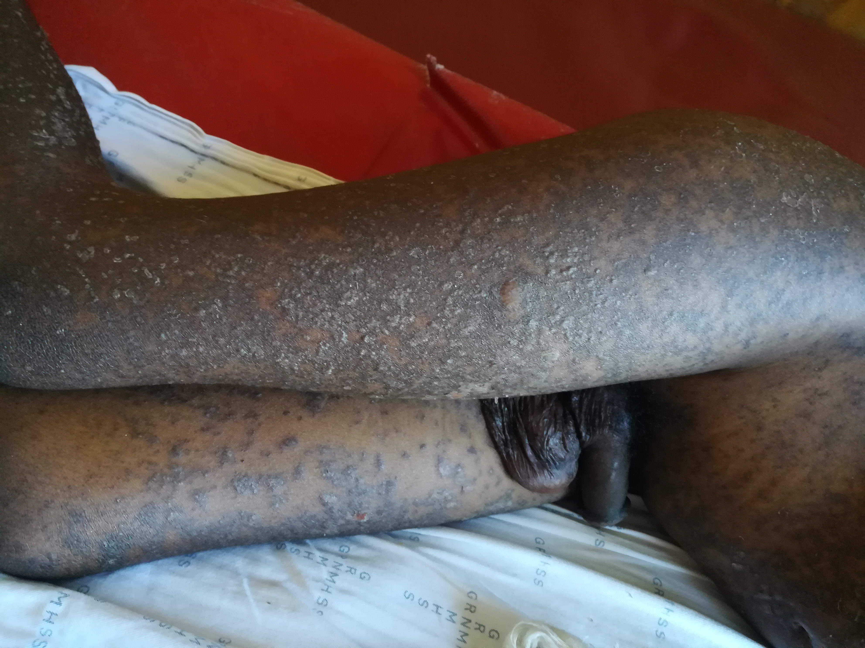
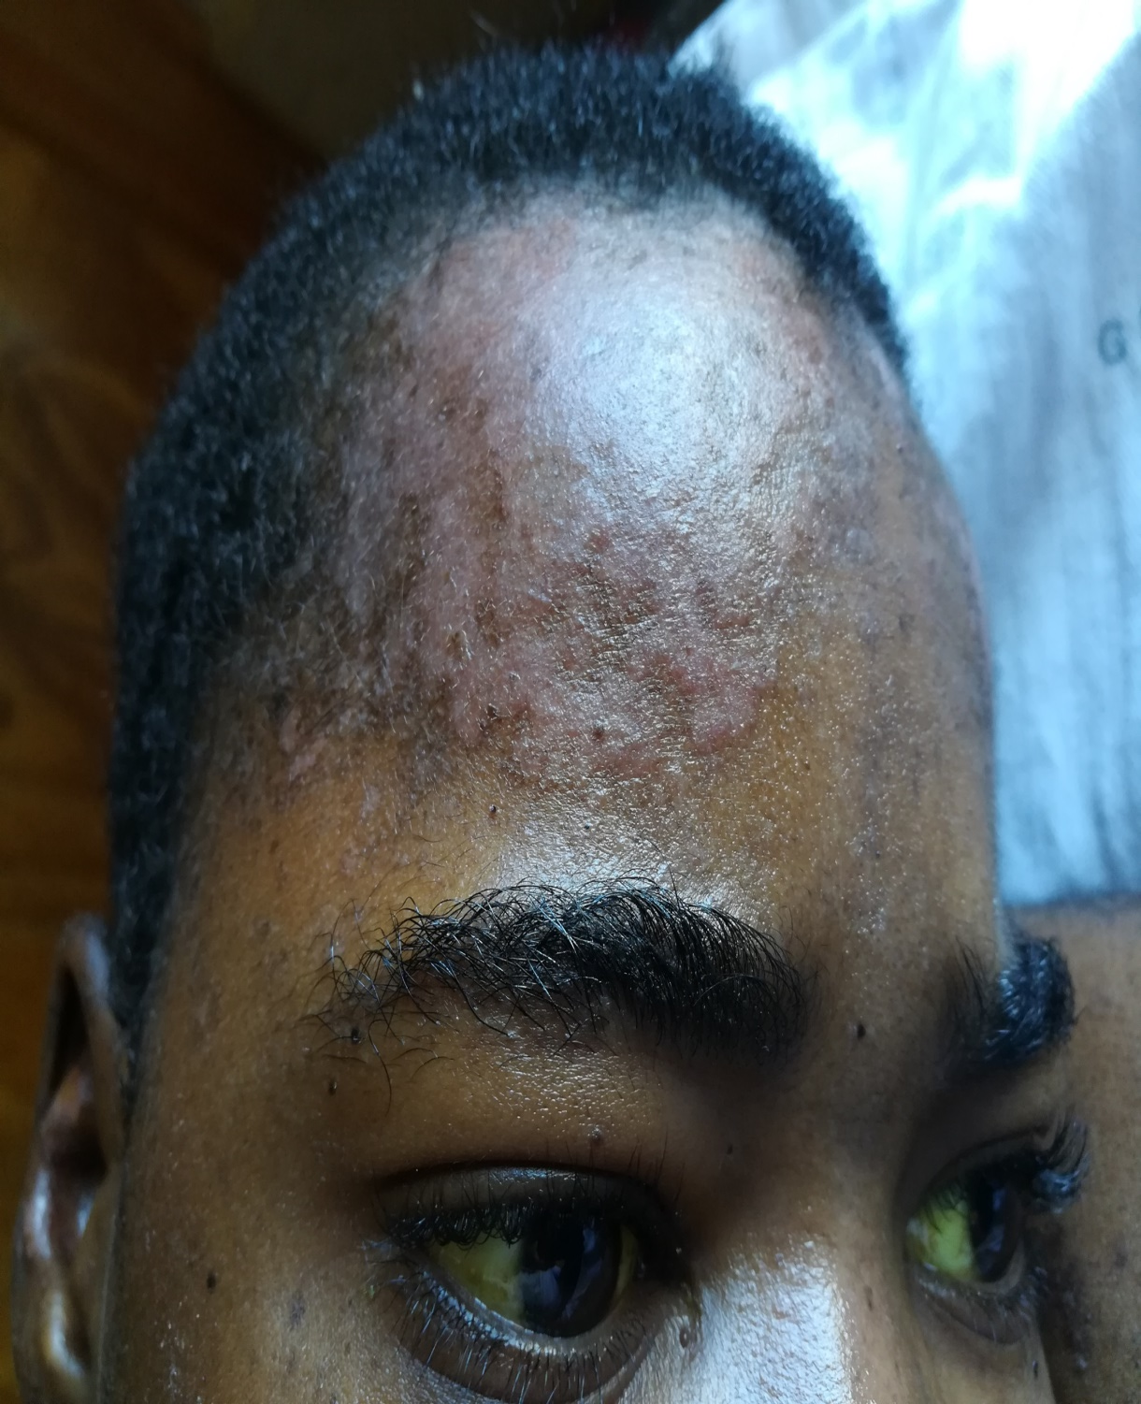
EFV 600mg
1.CNS
(Depression )

Slide 35
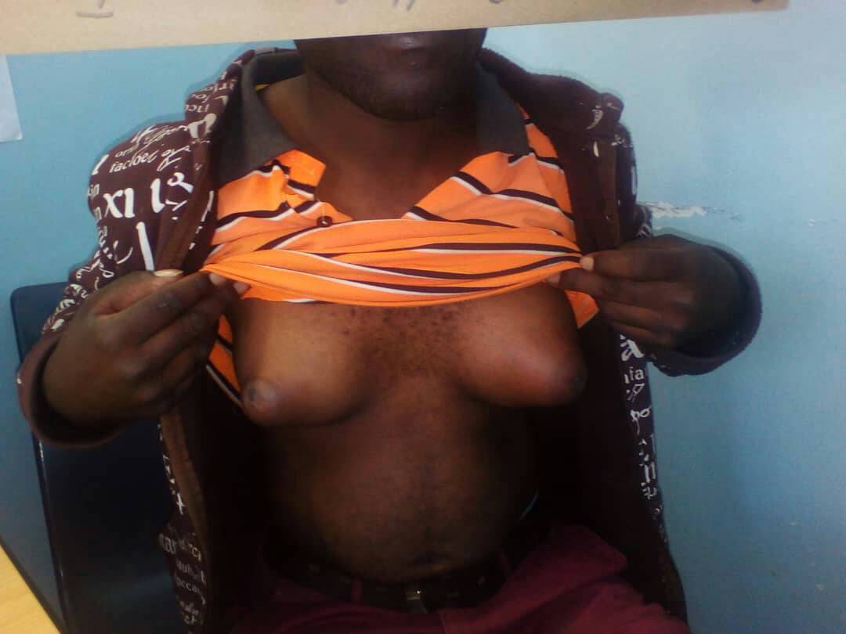

Male clients on EFV 600mg Cyt 2B6 Cyt 2A6

Slide 36
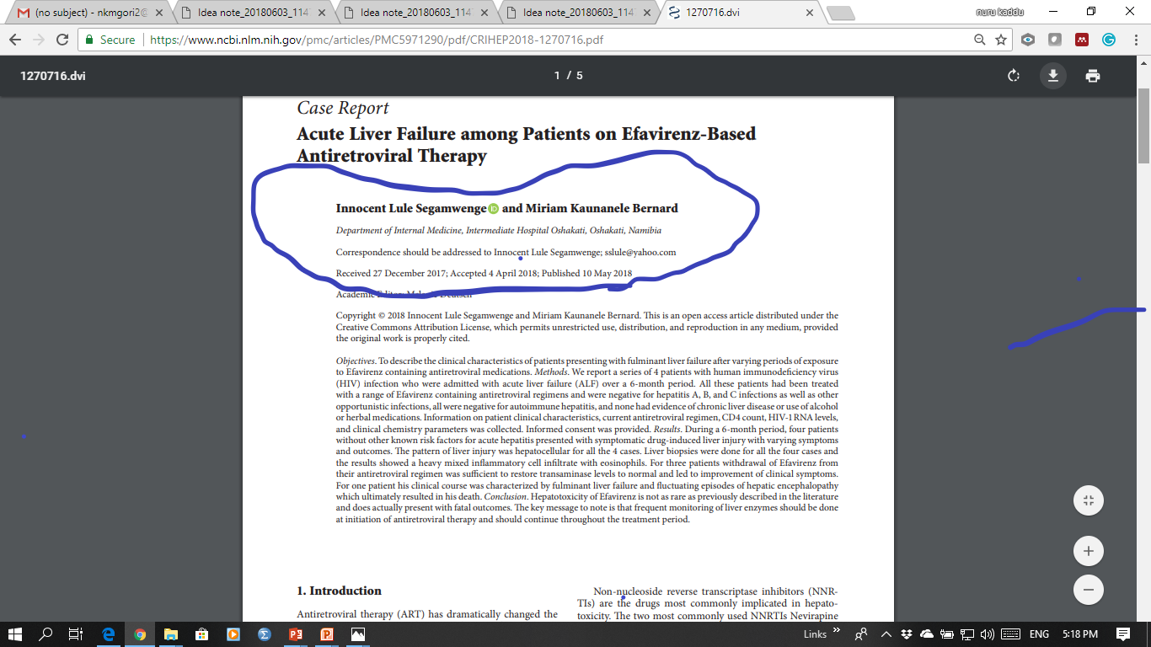

Slide 37
ENCORE1 Study: (EFV 400 mg vs 600 mg QD) + TDF/FTC
Design
Randomisation*
1 : 1
Double-blind
W48
W96
> 16 years
ARV-naïve
HIV RNA > 1,000 c/mL
CD4 cell count: 50-500/mm³
Creatinine clearance
> 50 mL/min
N = 324
TDF/FTC + EFV 400 mg (2 x 200 mg pills + 1 placebo pill) QD
N = 312
TDF/FTC + EFV 600 mg (3 x 200 mg pills) QD
*Randomisation was stratified by clinical site and by HIV RNA (< or > 100,000 c/mL) at screening
Objective
Non inferiority of EFV 400 mg at W48: % HIV RNA < 200 c/mL by modified intention to treat analysis (all randomised participants who received at least 1 dose of study drug and at least one follow-up visit), 2-sided significance level of 5%, lower margin of the 95% CI for the difference = -10%, 90% power
ENCORE1
Encore1 Study Group, Puls R. Lancet 2014;383:1474-82
Notes:
ARV-trial.com
37

Slide 38
ENCORE1 Study: (EFV 400 mg vs 600 mg QD) + TDF/FTC
Adverse events at week 48
 |  | EFV 400 + TDF/FTC | EFV 600 + TDF/FTC | P
Patients with adverse events |  | 89.1% | 88.4%
 | Grade 1 | 72.9% | 73.1%
 | Grade 2 | 22.5% | 21.5%
 | Grade 3 | 4.1% | 5.0%
 | Grade 4 | 0.4% | 0.4%
Serious adverse events, N patients |  | 23 (7.1%) | 22 (7.1%)
 | Related to study drugs | N = 3 | N = 4
Adverse events definitively or probably related to study drug, N patients |  | 118 (36.8%) | 146 (47.2%) | 0.008
 | Discontinuation due to drug-related adverse event | N = 6 (1.9%) | N = 18 (5.8%) | 0.01
Adverse events of specific interest
 | Neuro-psychiatric | 45% | 51% | NS
 | CNS | N = 231 | N = 272
 | Psychiatric | N = 13 | N = 12
 | Rash | N = 68 | N = 105
 | Gastrointestinal | N = 62 | N = 78
 | Hepatotoxicity | N = 1 | N = 0
ENCORE1
Encore1 Study Group, Puls R. Lancet 2014;383:1474-82
Notes:
ARV-trial.com
38

Slide 39
ENCORE1 Study: (EFV 400 mg vs 600 mg QD) + TDF/FTC
Conclusion
A reduced dose of 400 mg EFV QD is non-inferior to the standard dose of 600 mg QD, when combined with TDF/FTC during 48 weeks in ART-naive adults with HIV-1 infection
Overall, the frequency of adverse events did not differ and there was no evidence of difference in treatment cessation between groups
However, adverse events related to the study drug were more frequent with 600 mg EFV than with 400 mg, and discontinuation due to adverse events more frequent with EFV 600 mg
Quality of life, negative emotional state, and efavirenz side-effect based on specific questionnaires did not differ between EFV 600 and 400 mg QD
These findings provide an opportunity to reduce the unit costs of treatment and care models that are based on EFV use
ENCORE1
Encore1 Study Group, Puls R. Lancet 2014;383:1474-82
Notes:
ARV-trial.com
39

Slide 40
Discussion: How Soon to Start ART
Is same-day ART feasible?
What resources are needed to support same-day ART?
Experience in using the current first lines
What do the guidelines say?

Slide 41
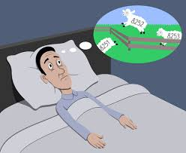

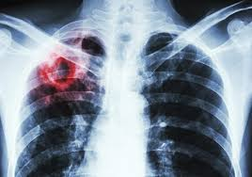

Major gaps on clinical use of dolutegravir
CNS side effects: higher than expected rate of DTG discontinuation due insomnia in observational studies (compared with RCTs) but very low occurrence of other side effects.
Risk of IRIS in PLHIV with advanced HIV disease: increased risk observed in observational studies but not detected in RCTs with other INSTIs (REALITY study)
HIV-associated TB: need to adjust dose if rifampin is used (pK and clinical studies with ongoing)
Pregnant/BF women: Limited safety data. Very high DTG concentrations in blood cord at birth (pK and clinical studies ongoing)

Slide 42
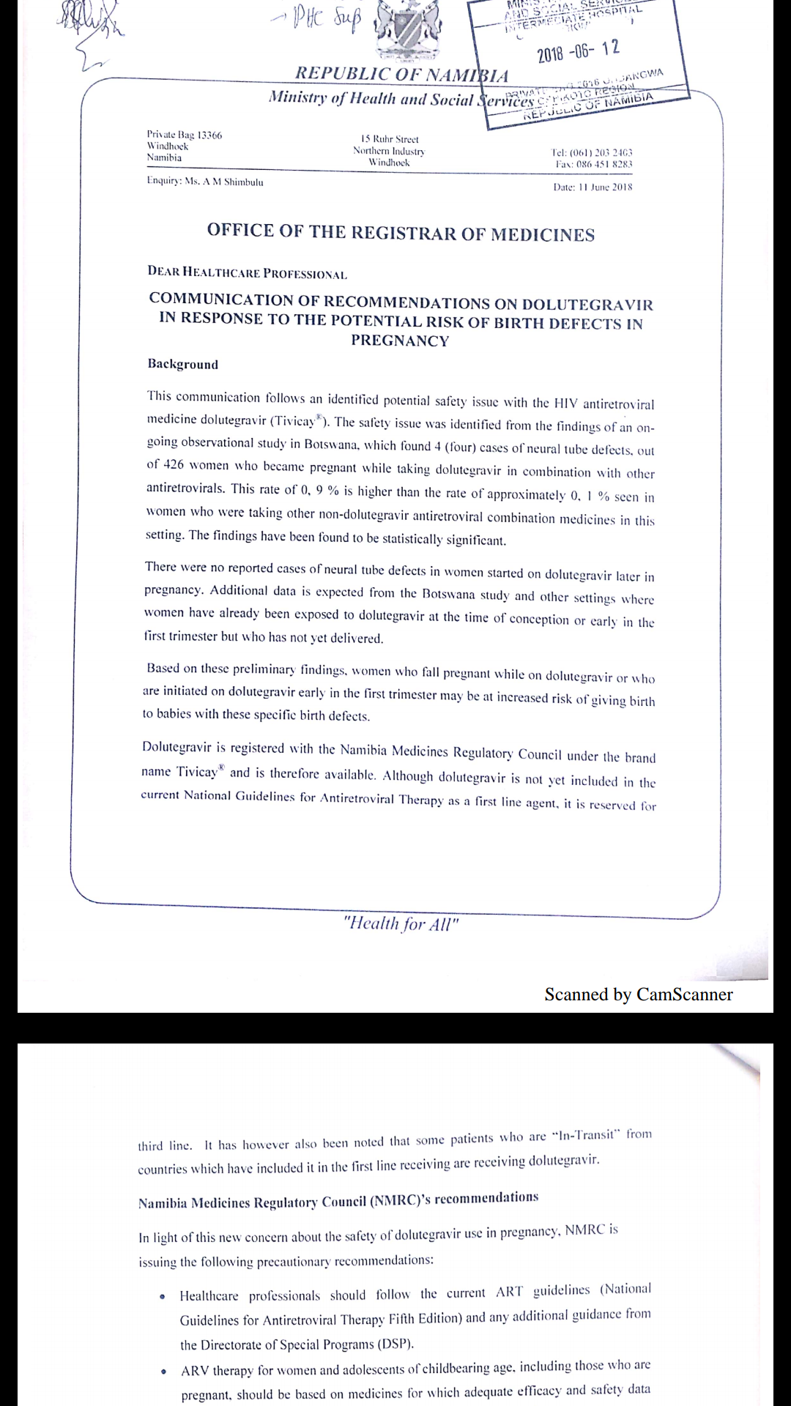
Pregnancy and DTG

Slide 43
Summary of optimization profiles of major new ARVs
Optimization criteria |  | DTG | EFV400 | DRV/r | RAL
Efficacy and safety | High virologic potency | ✓ | ✓ | ✓ | ✓
 | Low toxicity | ✓ | ✓ | ✓ | ✓
 | High genetic barrier to resistance | ✓ | ✗ | ✓ | ✗
Simplification | Available as generic FDC | ✓ | ✓ | ✗ | ✗
 | Low pill burden | ✓ | ✓ | ✗ | ✗
Harmonization | Use in pregnant women | ? | ✓ | ✓ | ✓
 | Use in children | ? | ✗✓ | ✓ | ✓
 | Use in HIV-associated TB | ? | ✓ | ✗ | ✓
 | Few drug interactions | ✓ | ✗ | ✗ | ✓
Cost | Low price | ✓ | ✓ | ✗ | ✗
✓ yes ✗ no ? ongoing studies
WHO policy brief transition to new ARVs in HIV programmes, Jul 2017

Slide 44
Timeline of Current Stock + Projection
TEE 600
TLE 400 (Govt) Stock
TLE 400 (GF) Stock

Slide 45
Transition –Use of EFV 400mg in Namibia
Newly diagnosed patients
Pregnant women and Breastfeeding mothers
Pts on TDF/XTC/EFV 600mg to TDF/XTC/EFV 400mg
Health education safety measure
Similar efficacy
Pt on TDF/XTC/EFV 600mg and High VL;
Switch to TDF/XTC/EFV 400mg
EAC and Consider 2nd Line

Slide 46
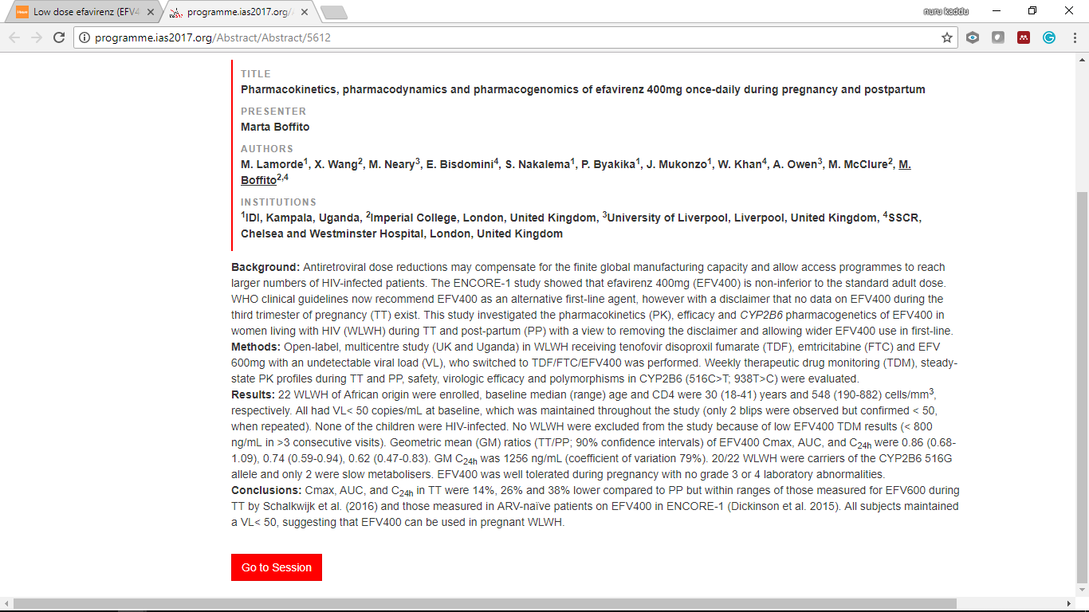
Low dose efavirenz (EFV400) can be used during pregnancy

Slide 47
Tuberculosis –Use of EFV 400mg- Namibia
TB Patients
Change to EFV 600mg (Rifampicin)
Diagnosed TB before ART
TDF/XTC/EFV 600mg—change to EFV 400mg (2 weeks post rx)

Slide 48
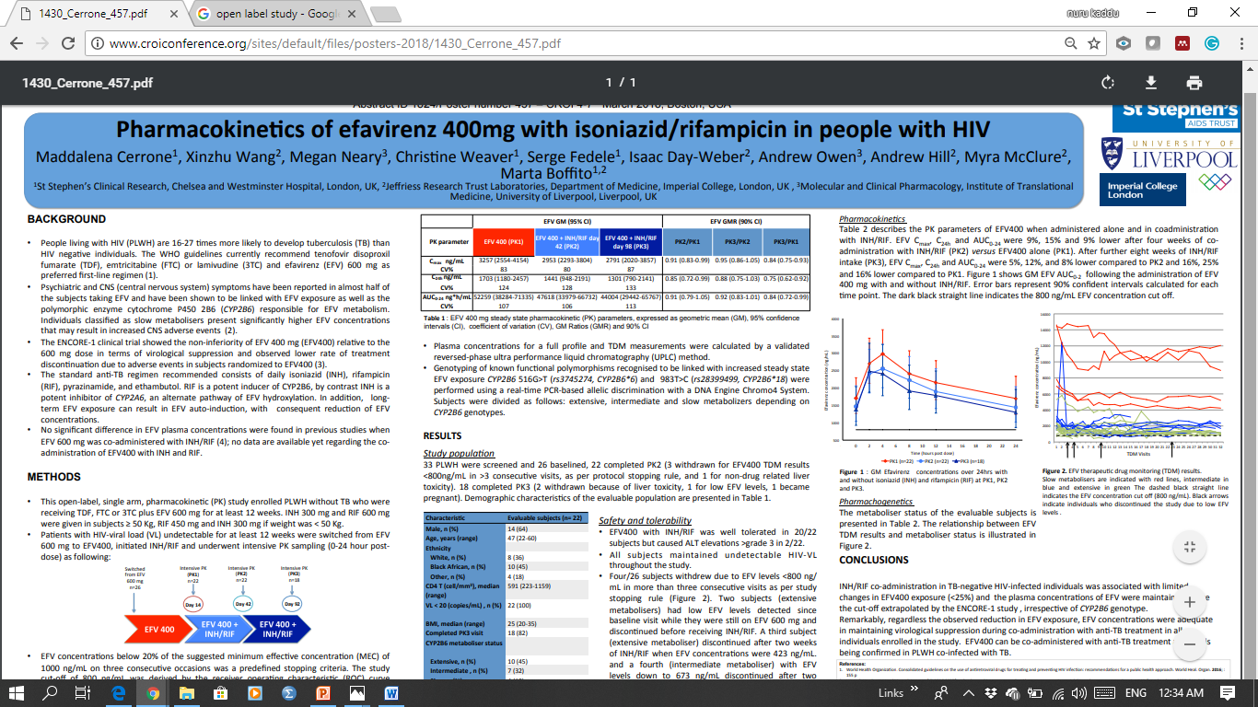
Low dose Efavirenz (EFV400) can be used during TB Rx

Slide 49
Pharmaceutical Services Coordination
TLE400 available at CMS
CMS and HIV sub-division working together to ensure smooth transition.
No new orders of TEE600 .

Slide 50
Rapid Dissemination Training
Need to provide information to health care workers.
"Transition to EFV 400 " presentation will be shared with sites and on ECHO
Disseminate presentation to all Partners, NHTC network, DSP including programme officers, etc
Mentors and Partners to conduct regional/district level training

Slide 51
M&E
New regimens in ePMS and EDT
Determine monitoring plan for the uptake of new regimen(s)
Engage Therapeutics Information and Pharmacovigilance Centre (TIPC) to plan for monitoring adverse medicine reactions
Plan underway to update the Patient Care Booklet

Slide 52
Clients And HCWs Education
Development of information pack for Clients and HCWs
Circulate and SOP for dissemination
Finalise information pack
Health education
Posters
Dissemination of information pack to CMs, partners, MoHSS program officers, etc

Slide 53
Clinical Scenarios

Slide 54
Scenario 1:
HIV-infected pregnant women already on ART during current pregnancy
Scenario 2:
All HIV positive pregnant and breastfeeding women (known and newly diagnosed) not currently on ART

Slide 55
Scenario 3: PW
37 years old male,
Presented with chronic cough, fever and night sweating,
He also complained of chest pain, progressive difficulty of breathing and lost some weight
P/E
Sick looking, Oxygen Saturation without Oxygen per nasal prongs was 65%
Bi-basilar crepitation

Slide 56
PW’s lab test results…
Sputum AFB: +++
Genexpert: M. Tb Positive, Rif. Sensitive
HIV rapid antibody test: reactive

Slide 57
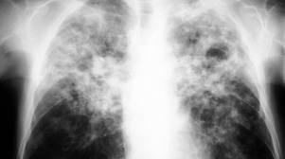
PW’s Chest X-ray…

Slide 58
What next?
Start TB treatment and consider ART after completion of TB treatment
Start TB treatment and commence ART within 2 weeks of TB treatment

Slide 59
PW..
He tolerated TB treatment well
His baseline Lab results came back
Retest HIV +
CD4: 154cells/ul
HBsAg: Reactive
Hb: 7.5g/dl
Cr for crcl: 70ml/min
Urine dipstick: No glucose or protein
CrAg: Negative
ALT: 20 WNL
He attended adherence counseling session and ready for ART

Slide 60
How do you manage his HIV as per Guidelines
I will start ART today
TDF/XTC/EFV 400mg
I will start ART today
TDF/XTC/EFV 600mg

Slide 61
Key Points
Scaling up Test and Treat
Same Day ART initiation or within 7days have better outcomes
EFV 400mg is safer and non inferior to EFV 600mg
EFV 400mg can be prescribe to pregnant women & BF
Namibia Guidelines implement EFV 600mg in TB patients

Slide 62

Thank you

